Slide 1
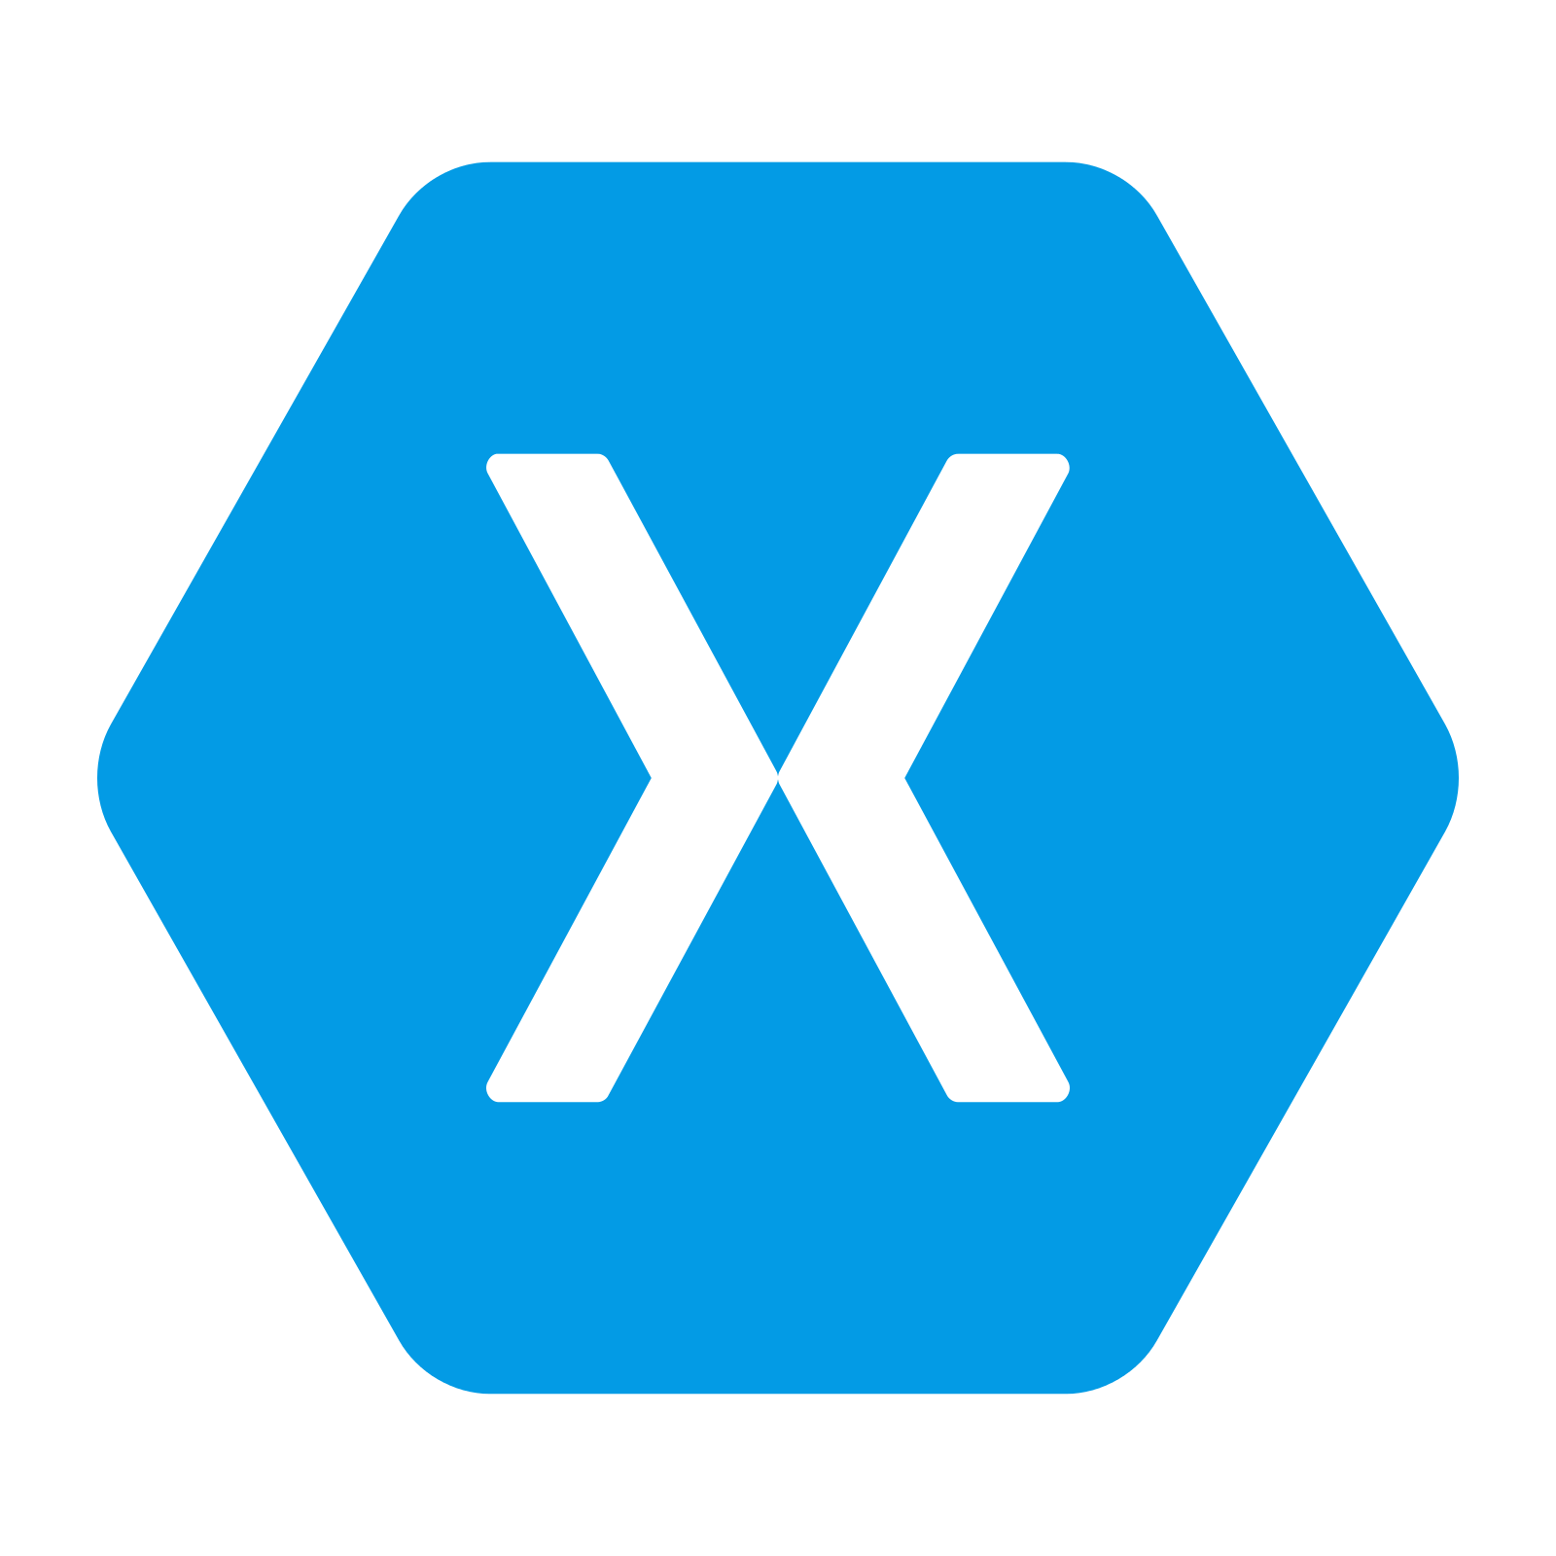
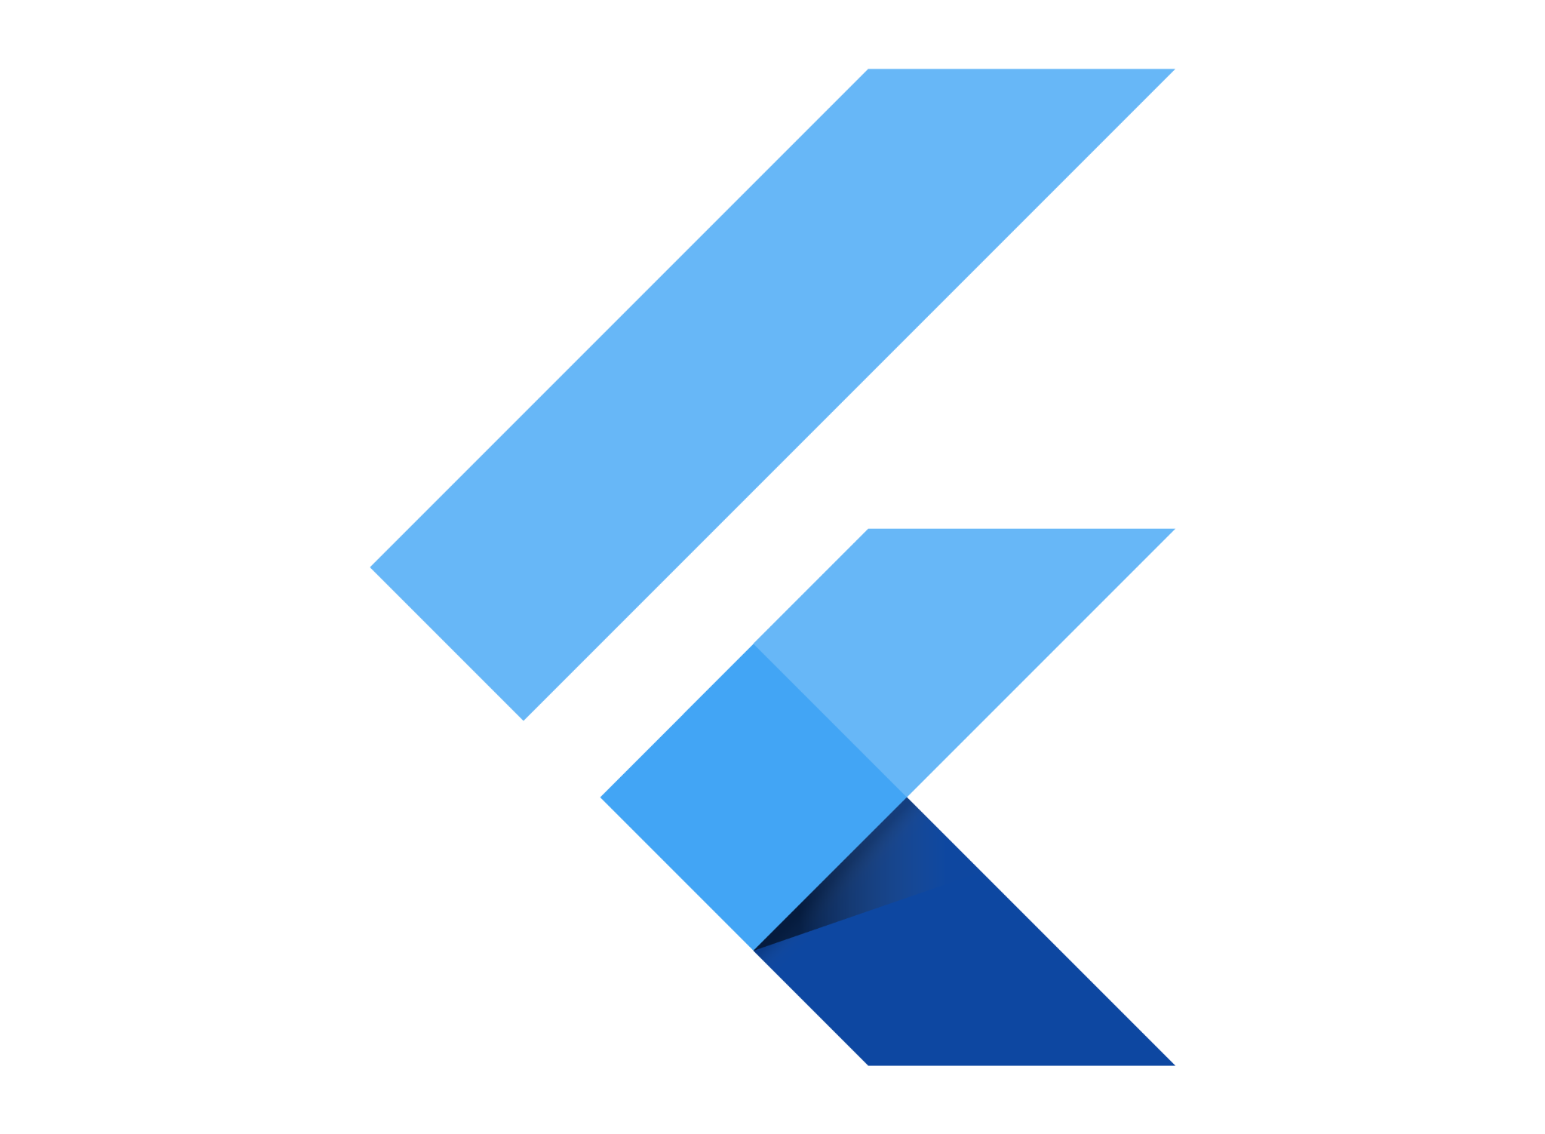

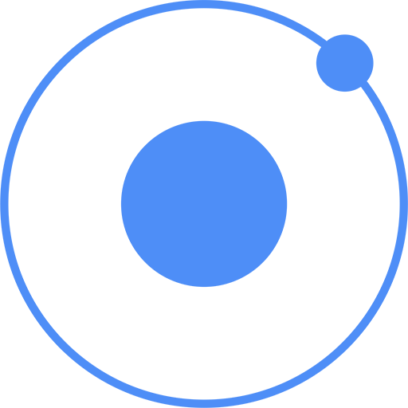
Mobile Apps
An Introductory Guide into the World of Native, Web, and Hybrid Applications

Slide 2
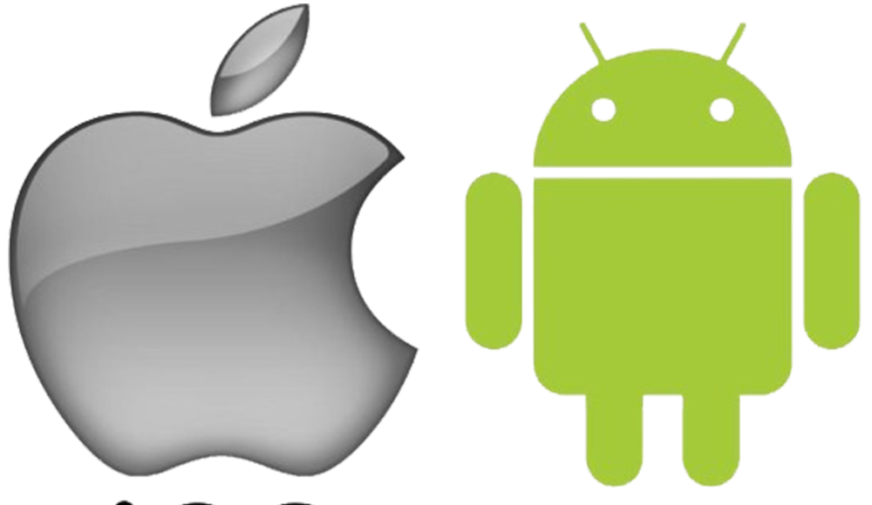
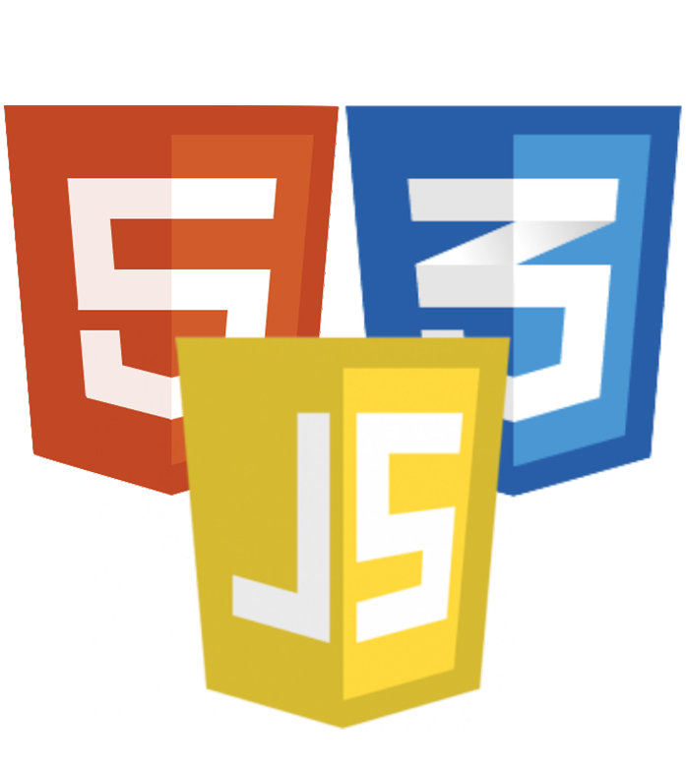
Types of Mobile Applications
Native
Designed specifically for one platform.
Fastest Seamless User Experience High Development Cost Long Time to Market
Web
Websites built for installation and access on Mobile devices
Slow Less Smooth Experience Low Development cost Shortest Time To Market
Hybrid
A combination of both native and web applications
Faster than web More seamless than web Low Development cost Shorter Time to Market

Slide 3
Programming Languages Used for Mobile App Development

Slide 4


Java
Swift
Java is a popular object-oriented programming language used for developing Android apps, both native and cross-platform, as well as for server-side development. It is known for its robustness and reliability.
FEATURES
Portability
Object-oriented programming
Garbage Collection
Cross-platform development
Swift is the primary programming language for iOS app development, created by Apple to be fast, safe, and easy to learn. It's a modern language optimized for performance and is used for developing native iOS apps.
FEATURES
Safety
Speed
Interoperability
Easy to learn
Open-source

Slide 5
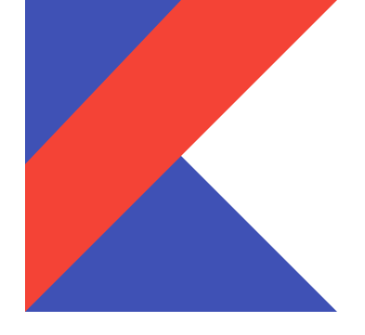
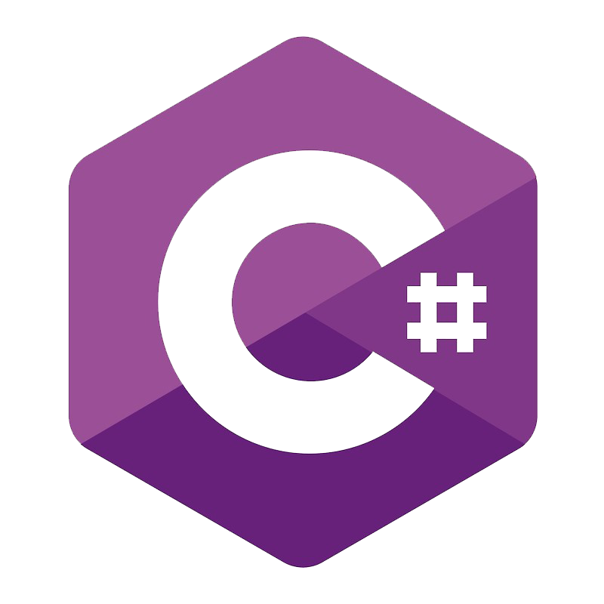
Kotlin
C#
Kotlin is a modern, open-source programming language that is gaining popularity for Android app development due to its concise and expressive design. It is fully interoperable with Java, allowing developers to integrate Kotlin code into existing Java projects.
FEATURES
Concise syntax
Interoperability
Null safety
Extension functions
Functional programming
Swift is the primary programming language for iOS app development, created by Apple to be fast, safe, and easy to learn. It's a modern language optimized for performance and is used for developing native iOS apps.
FEATURES
Versatility
Object-oriented programming
Asynchronous programming
Garbage Collection
Interoperability

Slide 6


Dart
Javascript
Dart, an object-oriented programming language developed by Google, is used for building web, desktop, mobile, and server applications. With a syntax similar to Java and C++, Dart is designed for easy learning and use.
FEATURES
Asynchronous programming
Garbage collection
Flutter framework
Interoperability
JavaScript, a high-level, dynamic, and interpreted language, is one of the most popular programming languages used in mobile app development .It is primarily used for building hybrid and web-based mobile applications.
FEATURES
Cross-platform compatibility
Lightweight
Flexibility
Rich libraries
Easy to learn

Slide 7
Mobile App Development Frameworks
A mobile app development framework is a collection of pre-built components, modules, libraries, and APIs that provide developers with a platform and set of tools to build mobile applications quickly and efficiently. It offers a software framework to build mobile apps.
UI Design Tools
Cross Platform
Native Performance
Security
Backend Integration
Testing & Debugging

Slide 8
React Native
React Native is an open-source framework using JavaScript, allowing developers to build high-performance native mobile apps for iOS and Android platforms. It has an active community, wide range of plugins, and libraries.
Pros
Allows apps to look like native apps Ready-made components allow for faster development time. Access to native functionalities. Allow further optimization of native apps. Hot reload to recompile the apps.
Cons
Navigation is not seamless Complex User Interface

Slide 9
Flutter
Flutter is an open-source framework developed by Google, using Dart programming language, for building native mobile apps. It offers fast development speed, hot reloading, and requires learning Dart programming language.
Pros
Complete development ecosystem. Ability to create your apps or customize pre-existing ones. Developed and supported by Google.
Cons
Since the app size can be too large, developers might need to reduce the number of libraries and packages. Does not expose many native APIs for use. It increases dependency on the ecosystem.

Slide 10
Ionic
Ionic is an open-source framework using JavaScript, HTML, and CSS to build hybrid mobile apps for iOS and Android platforms. It offers fast development speed, ease of use, and a wide range of pre-built UI components and plugins.
Pros
Develop an app once. Rich and robust applications. Minimal maintenance.
Cons
Performance is not as quick as it needs to be. It requires a specific skill set to build complex apps. Navigation can be notably complex.

Slide 11
Xamarin
Xamarin is a cross-platform development framework using C# programming language to build native mobile apps for iOS and Android platforms, offering strong performance and native look and feel.
Pros
Xamarin apps act almost like native apps. Offers seamless experience. It is free for small teams
Cons
There is a delay in updating which may cause issues with the app. Larger app size. Heavy graphics. Platform specific code

Slide 12
Requirements Collection
and Analysis
Non functional
Requirements
Validate
Requirements
Define Scope
Identify
Stakeholders
Prioritize Requirements
Document
Requirements
Functional
Requirements
Use Cases and
User stories
Analyze
Requirements
01
04
07
02
05
08
03
06
09

Slide 13
Development Cost Estimation
Include
Maintenance
Cost
Define Requirements
Choose
Billing Method
Choose
Platform
Estimate
Development Time
Calculate
Total

Slide 14





Our Team
Acha Rha’ah
Tambe Salome
Amehmbo Sonia
Atem Randy
Samuel Tiokeng

Slide 15
Thank You!
Do you have any questions?

